Slide 1
Explore Efficiencies and
Uncover Opportunities
May 16, 2023

Slide 2
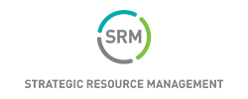
Richard Widdon
SVP Business Development

Slide 3



Strategic
Resource Management
Prepared for:
Cornerstone Resources Partner Showcase
2023 Overview

Slide 4
Contents
Introduction to SRM
Vendor Sourcing
Sievewright & Associates, an SRM Company
Advisory Services
Account Boost from SRM

Slide 5


Founded in 1992
Offices in United States and Europe
Headquartered in Memphis, TN
Strategic Resource Management
Proven Experience
Background
Leading advisory firm to financial institutions
1,000+ clients, 8,000+ projects
SRM has helped 1,000+ financial institutions add more than $5 billion of value to their bottom line in areas such as payments, digital transformation, core processing, artificial intelligence, digital assets, and overall operating efficiency.
We take a holistic view of your institution’s needs to offer value-generating services. And our expanded footprint allows us to bring the best experts from across the globe to your engagement.
Diversified Practice
Vendor contract negotiation and cost savings, revenue growth, and critical advisory services
Proprietary Benchmark Data
Real time assessment of vendor and industry activities and trends
Quantifiable Results
$5B+ of value to clients’ bottom line
$100M+ value per year on average

Slide 6























Vendors & Technology
Strategic Resource Management
Where We Come From
Consulting Firms
Our team brings experience to you from the biggest names among vendors, global management consulting firms, and
financial institutions.
Financial Institutions

Slide 7
Asset Size | Market Share | Clients Served
$70M to $1B | 24% | 365
$1B to $5B | 39% | 133
$5B to $10B | 36% | 16
$10B+ | 40% | 8
We Know
Credit Unions:
Of All Credit Unions Over $70M in Assets,
27% are SRM Clients

Slide 8


















National & Cooperative Partnerships:
League Partnerships:

Slide 9













A Sampling of SRM Clients

Slide 10
Vendor Sourcing

Slide 11
Vendor Sourcing Experience
SRM has more experience managing RFPs and negotiating with third party service providers on behalf of our clients than any other advisory firm.
Emerging Tech
Payments
Technology
Operations
Signature Networks
PIN/POS Networks
Card Processing
Merchant Processing
Loyalty & Rewards
Checks
Core Processing
Digital Banking
Account Origination
ATM & ITM Purchases
Customer Relationship Management (CRM)
ATM Maintenance
Armored Car
Credit Bureau Data
Equipment Maintenance
Telecommunications
AML/BSA
Blockchain & Cryptocurrency Solutions
Conversational AI (Chatbots)
Robotic Process Automation

Slide 12
Client
Vendor
Vendors Often Have Leverage When Entering Contract Negotiations
Negotiate Agreements
Every 3-5 Years
Negotiate Dozens of
Agreements Each Year
Resources Focused on
Business Growth
Resources Dedicated to
Negotiating Contracts
High Transition Costs
Limited Threat of
Client Attrition
Limited View of Market Terms
Broad View of Market Terms

Slide 13
Holistic
Approach,
Simple Process
1.
After onboarding a new client, SRM will collect copies of contracts and invoices for the selected project areas.
2.
Within two weeks SRM will present the results of the assessment, demonstrate what the benchmarks indicate, and agree on a strategy.
Optimization is the key word
for what we do.
At SRM, we don’t just look at our work with you as one negotiation – we want to understand the complete picture and help you build on your bottom-line savings
and performance.
3.
We’ll begin to conduct productive, diplomatic negotiations with the vendor(s) until market conditions are reached.
4.
SRM will audit invoices and track savings & contract enhancements. In most cases, our compensation is based on performance.

Slide 14



2022 Project Snapshot
570
161
77
Projects Initiated
Projects Completed
Competitive Vendor RFPs Supported

Slide 15

Sievewright & Associates, an SRM Company

Slide 16




Sievewright & Associates
Key Services
Strategic Planning Services
Strategic Leadership Series
Digital Transformation
Trends Presentations
Meeting Facilitation
Strategic Plan Development
Strategic Dialogue Sessions
Education Sessions
Thought-Leadership Program
Targeted at Board & C-Level
Perspectives Reports
Web Portal Access
Annual Membership Fee
Strategic Leadership Forum
DigitalMAPSM
Digital Assessments
Digital Strategy Development
Keynote Presentations

Slide 17
Account
Boost

Slide 18



Performance Based Marketing
Account Boost programs have generated nearly $4 billion in deposits and loans for community-based financial institutions. Member data reaches its full potential with SRM’s custom offering.
Pay for Performance Member Cross-Sell
New Member Onboarding
New Member Acquisition
Checking
Loan Generation
Deposits Gathering
Transactional (Debit, Online Banking, Mobile)
Optimize Retention
Accelerate Profitability
Lead with Checking
Align Segments with Objectives

Slide 19
Boost Opportunity Assessment
1.
Presented in person annually to help assess if programs are moving the needle.
2.
Includes detailed recommendations and associated proforma.
Clients receive an Opportunity Assessment that lays out key member data findings, as well as the data-driven growth opportunities that lie ahead.
The Opportunity Assessment provides the “aha” moment for clients to see how
Account Boost can help them meet cross-sell, utilization, and acquisition growth goals.
3.
Presentation includes what peers are saying about how their strategies drive performance.
4.
SRM will audit invoices and track savings & contract enhancements. Our compensation is based on performance.

Slide 20

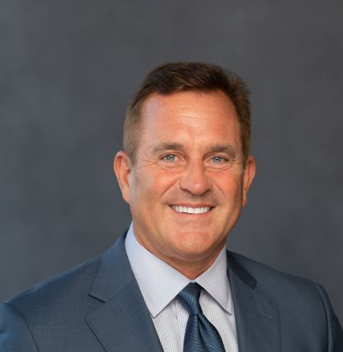


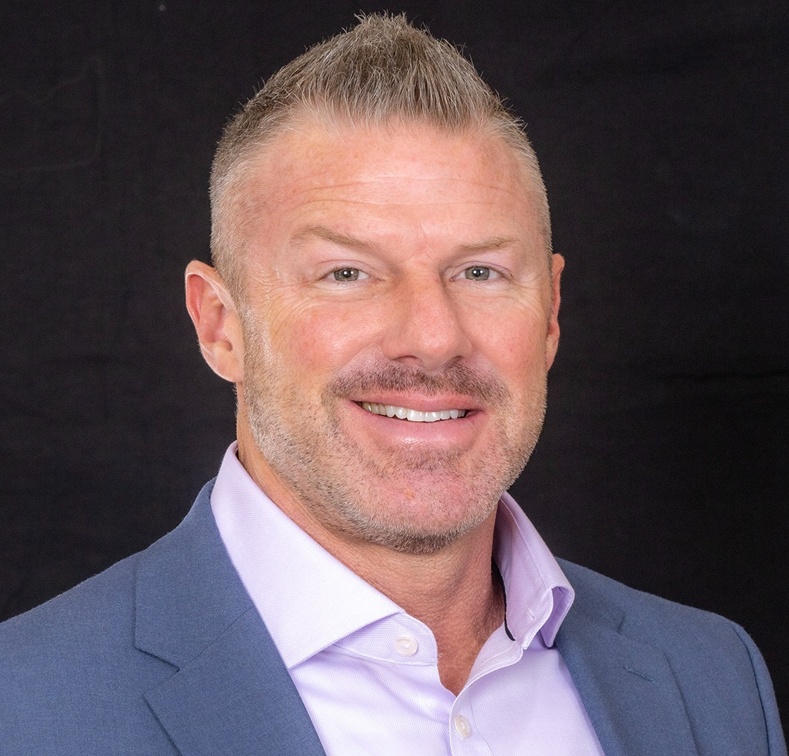
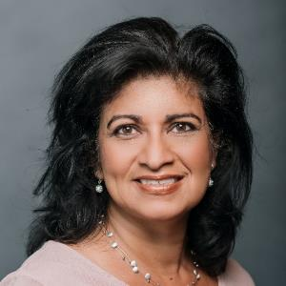
RICHARD WHIDDON
SVP, Business Development
Memphis, TN
rwhiddon@srmcorp.com
(901) 692-4860
Business Development Territory: TX, OK, AR
KUNTAL VORA
VP, Client Management
Castle Rock, CO
kvora@srmcorp.com
(303) 929-7129
Client Management Territory: TX, OK, AR, MO, KS
SRM Key Contacts
Next Steps to engage with SRM
MIKE HINES
Vice President, Business Development
Indianapolis, IN
mhines@srmcorp.com
(317) 739-7834
Business Development Territory: MO, KS
UMA ZIELINSKI
RVP, Client Development
Columbus, OH
uzielinski@srmcorp.com
(740) 400-9141
srmcorp.com
SRM Proprietary & Confidential
20

Slide 21
SRM Appendix:

Slide 22
Business Overview
SRM’s experience delivering value to our financial institution clients is unparalleled in our industry.
Digital Transformation
Vendor Sourcing
Consumer Engagement
Strategy
Payments
Strategic Planning
Mergers & Acquisitions
Capability Maturity Modeling
Operating Model & Organizational Design
Product Assessments
Digital/Core/Fintech Assessments
Strategy Development & Technology Roadmap
Digital Asset Education & Strategy
Banking as a Service Advisory
Partner Assessment & Selection
Payments
Strategy
Operational Assessment & Benchmarking
Portfolio Optimization
Risk Management
Partner Assessment & Selection
Benchmarking
Due Diligence
RFP Customization
Vendor Demos, Comparison & Scoring
Financial Analysis
Contract Negotiation
Implementation Support
Measurement, Tracking & Auditing
Account Level Data Analytics
Householding & Segmentation
Account Growth Campaigns
Mobile App Engagement
Program Execution
Success Tracking & ROI

Slide 23

Case Study
SRM began working with the leadership team at Texans Credit Union in 2021 following a standing relationship with the credit union’s new leader, President & CEO David Frazier. His team’s directive was to modernize the credit union’s technology and improve member experience through those enhancements. Based on his previous experiences with SRM, Frazier was confident our firm could contribute to the speed and overall success of the endeavor ahead.
The trust and rapport developed over the success of the payment realignment project led Texans Credit Union to enlist SRM for new initiatives that will further its continued growth.
Future projects may include digital assets and crypto solutions strategy, SRM’s Account Boost data-driven marketing solution, and AP reports consulting. Additionally, SRM’s operational advisory services are available to serve as an extension of the Texans Credit Union team when needed.
Notes:
Vertical: Operational Advisory
Project Type: Organizational CMA
Qual/Results: ANBTx - SRM identified 150+ key initiatives to close the gap between the current state and desired state capability maturities, based on deep dives into bank structure, strategy, goals, ambitions, business capability maturity levels, and corporate roadmap. Following the initial assessment, SRM supported implementation of a number of the identified high-priorities initiatives, including developing a Technology Strategy, a Finance & Accounting Strategy, and a Succession Plan.

Slide 24
Account Boost Making an Impact
Since onboarding to Account Boost in 2021, People First Federal Credit Union has added over 500 new loans averaging at least
$9 million in balances each quarter.
And over 50 new checking accounts – all at an attractive fixed per account fee.

Slide 25

Case Study
SRM began working with the revenue leadership team at Vantage Credit Union in 2022 with an initial Opportunity Assessment study to understand key strategic opportunities for more rapid growth as well as risk factors that could inhibit growth.
Based on the assessment, Vantage initiated an Account Boost program focused on omni-channel member relationship expansion and results have exceeded expectations.
During 2022, Account Boost generated over $50 million of new balances and over 2,100 new accounts at a fixed cost per acquisition which exceeded the pro-forma estimates provided during the initial assessment. Based on the strong results in a partial year 1, Vantage has renewed and expanded the Boost program for year 2.
Notes:
Vertical: Operational Advisory
Project Type: Organizational CMA
Qual/Results: ANBTx - SRM identified 150+ key initiatives to close the gap between the current state and desired state capability maturities, based on deep dives into bank structure, strategy, goals, ambitions, business capability maturity levels, and corporate roadmap. Following the initial assessment, SRM supported implementation of a number of the identified high-priorities initiatives, including developing a Technology Strategy, a Finance & Accounting Strategy, and a Succession Plan.

Slide 26
Background on Sievewright & Associates
Since April 2017, Mark Sievewright has been engaged in more than 150 individual CU Strategic Planning meetings.
Mark moderated CUNA’s 2020 National CEO Roundtable Event for the fourth consecutive year and for the sixth time in his career. The event is an invitation-only event open to CEOs of the country’s Top 100 credit unions.
Mark was a Contributing Author (for the eighth consecutive year) to CUNA’s E-Scan Report
For the 11th consecutive year, Mark was a member of the faculty at the CUNA Management School
In December 2020, Mark delivered a virtual (global) event for the World Council of Credit Unions focused on Digital Transformation
In February 2021, Mark was appointed as the Lead Subject Matter Expert for the newly established CUNA Digital Transformation Task Force comprised of CU leaders from around the country.
In November 2021, Mark facilitated discussions at CUNA’s ONES Dialog meeting held in Washington, DC. This meeting comprises the Top 25 Credit Union CEOs in the country by asset size.

Slide 27
What is DigitalMAP?
Strategic Goals
What are the areas of focus for your credit union?
How do you want to differentiate?
How has technology helped or hurt your efforts?
The Digital Maturity Assessment Program is designed to help credit unions understand their current digital ecosystem and how it compares to industry best practices.
The assessment is a vital component in developing a Digital Roadmap or Action Plan based on the credit union’s strategic goals and appetite for innovation.
Innovation
What business areas are lacking innovation? Why?
What business areas are innovative? Why?
How do you measure your innovation level?

Slide 28
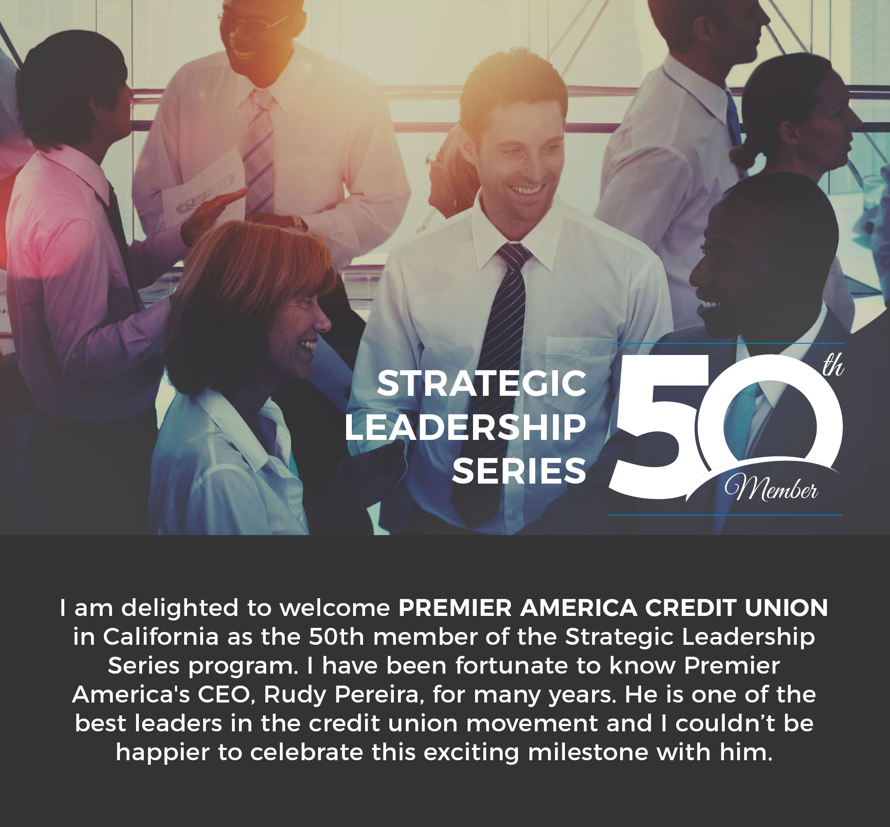
Overview of the Strategic Leadership Series:
An Annual Membership Service for Credit Unions
Access to Perspectives Reports
The SLS now has close to 70 members who receive access (via a Web Portal) to Perspectives Reports (authored by Mark) on Strategic Trends, including:
  Business Model Change
  Delivery & Distribution Channels
  Emerging Technologies
  FinTech Sector
  Member Experience
  Payment Services and Systems
  Regulation and Compliance
  Service Quality
  Small Business Trends
  Strategic Planning
  Technology Strategy

Slide 29



What Clients Say about Sievewright & Associates
“From day one, Mark was willing to extend himself and his colleagues in any manner necessary in order to achieve our organization's business objectives.
I have not met any other individual in my career with more integrity, professionalism and dedication to his profession than Mark Sievewright.”
“I cannot begin to express my gratitude for your guidance and commitment to our credit union. We could not have done this (core system evaluation and selection) without you. You were an outstanding choice to lead us though this. I could not make a higher recommendation to anyone if they want the best technology advice possible.”
“Mark supported us with the identification and recruitment of a new CEO for our credit union in very challenging circumstances (the new CEO would be the third in less than 3 years). We did not want the “boiler-plate” recruitment approach offered by many of the traditional firms. Mark brought us an outstanding candidate pool and guided us through an effective process of deciding upon our next CEO who has already been very successful in his first few years.”
Dave Roughton
President & CEO
SAFE Credit Union (CA)
Sean Cahill
President & CEO
True Sky Credit Union
Dan Egan
Board Member
Service Credit Union (NH)

Slide 30

Next Presentation:

Slide 31


May 15, 2023
ATM& ITM-As-a-Service

Slide 32

Our Global Payment Network
We process digital and cash transactions, while serving businesses and banked/underbanked customers through crucial services such as money transfers, credit and debit processing, ATM, POS services, digital content distribution, currency exchange and more
10.4 billion
Annual Transactions
50,000+
ATMs fully managed
180,000+
ATMs with Euronet SW
188+
Countries
500+
FI Customers
360,000+
Retail location installations
615,000
EFT POS Terminals
816,000
POS in prepaid network
522,000
Money transfer locations
180+
Currencies Supported
3.6 billion
Bank Accounts in remittance network
439 million
Mobile Wallet accounts

Slide 33
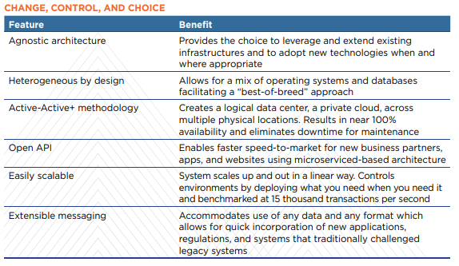

RENTM
State of the art open architecture switching with 24/7 high availability and fully scalable
REN technology is powering our Global Payments Infrastructure, integrating Physical and Digital Assets.
Unique Microservices Architecture
With multiple integration and deployment models
Smooth migration leveraging existing Bank resources
Ensures business continuity
Enables Cloud based Architectures and provides access to Euronet assets
100% Uptime for over 9 years!

Slide 34

Scale And Experience
Dolphin Debit. Your Trusted Partner for Financial Institutions across the U.S.
360+
Financial Institutions Clients,
with assets from
$5 Million to $1.9 Trillion
$3.0+ Billion
in annual ATM Vault Cash
2,600+ ATMs
Across the United States
Founded in 2005 with offices in Houston, TX & New Orleans, LA
Wholly Owned Subsidiary of Euronet Worldwide, Inc.
Full-Service ATM Management Company
The only “Pure-Play” ATM Outsourcing Provider in U.S.
Exclusive ATM Outsourcing Partners: MI CU League, CSC ATM, RMC ATM, Equips,
Cornerstone League, CT CU League, MDDCCUA, MSCUA, Volcorp, TN CUL & CCUA…

Slide 35





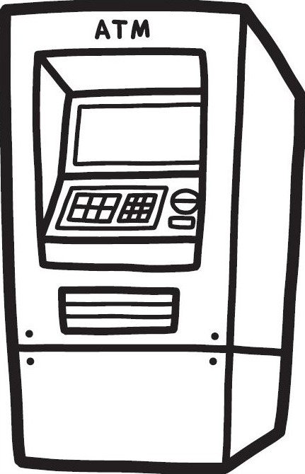

ATMs are a Struggle…
What is ATM Management?
Use white bold for headlines

Slide 36
ATMs are a Struggle…
What is ATM Management?
Use white bold for headlines
Current Ratio:
1/15 FTE to ATM
$60k in FTE costs

Slide 37
ATM-As-a-Service
Why Outsource ATMs?
Headache and hassle of managing, monitoring, updating, patching, etc.
Capital expense required for upgrades, future ATM replacements and next compliance requirement
ATM ownership costs continue to increase
ATMs are not a money maker, reduce expenses and cap out-of-scope charges
Consolidate from 4 or 5 ATMs vendors to 1 expert partner
Free up staff from fleet responsibilities and focus on core competencies
Future technology enhancements & requirements
Dolphin becomes your ATM & ITM department

Slide 38
Typical ATM-ITM Solution
Services Included
ITM Project
ITM Assets
Cash Management
ITM Servicing
Software
ITM Operations
Resources
Professional Services
ITM Ownership
Cash Forecasting
ITM Monitoring
Core Integration SW Subscription Licensing from NH
Whitelisting & Hard Drive Encryption
Reallocate Internal ATM Resources
Project Management
ITM Installation
Cash Ordering
Dispatch
Active Teller SW Subscription Licensing from NH
Ventus VPN Connectivity
Surcharge-Free ATM Alliance
Site Survey
Equipment /
Asset Insurance
Armored
Car Cash Replenishment
Remote Trouble-Shooting and Fix
Active Teller Workstation/Tablet Licenses from NH
Quarterly Marketing Screens
Economies of Scale
Rigging & Installation
Vandalism / Theft
(DD to fix, repair or
replace ATM)
Out of Balance Resolution
FLM Service*
(bill jams, paper jams, reboots etc)
ITM Resident SW Licenses/Annual SW Maint.
Receipt Paper / Peripherals
Bring Live
Future Compliance Upgrades
(no additional cost)
Reconciliation
SLM Service
(break and fix,
includes parts)
Security Updates & Patching
Annual Inspections /
ADA Audits
On-Site Training
Settlement
No Out-of-Scope Fees
W10 Licenses
EJ Retrieval
38

Slide 39
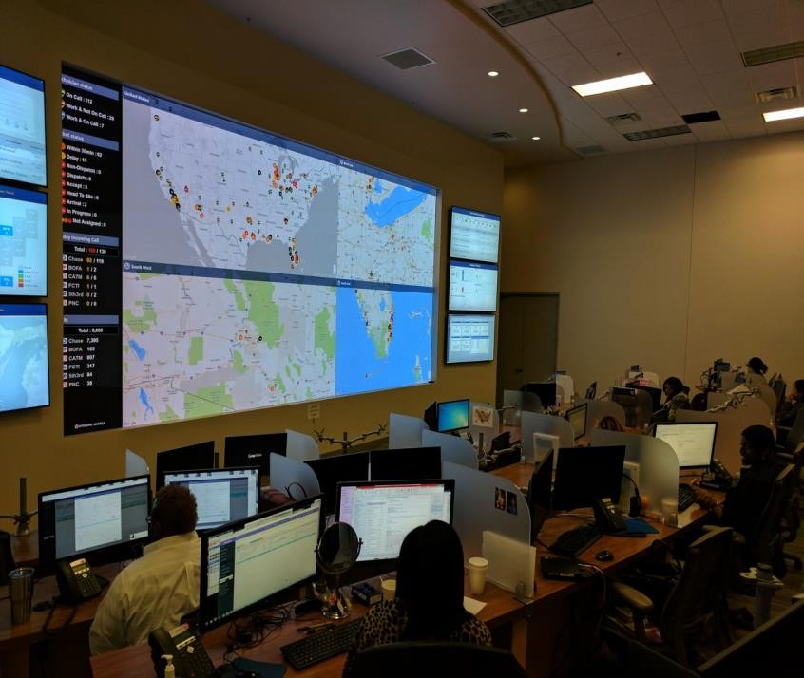
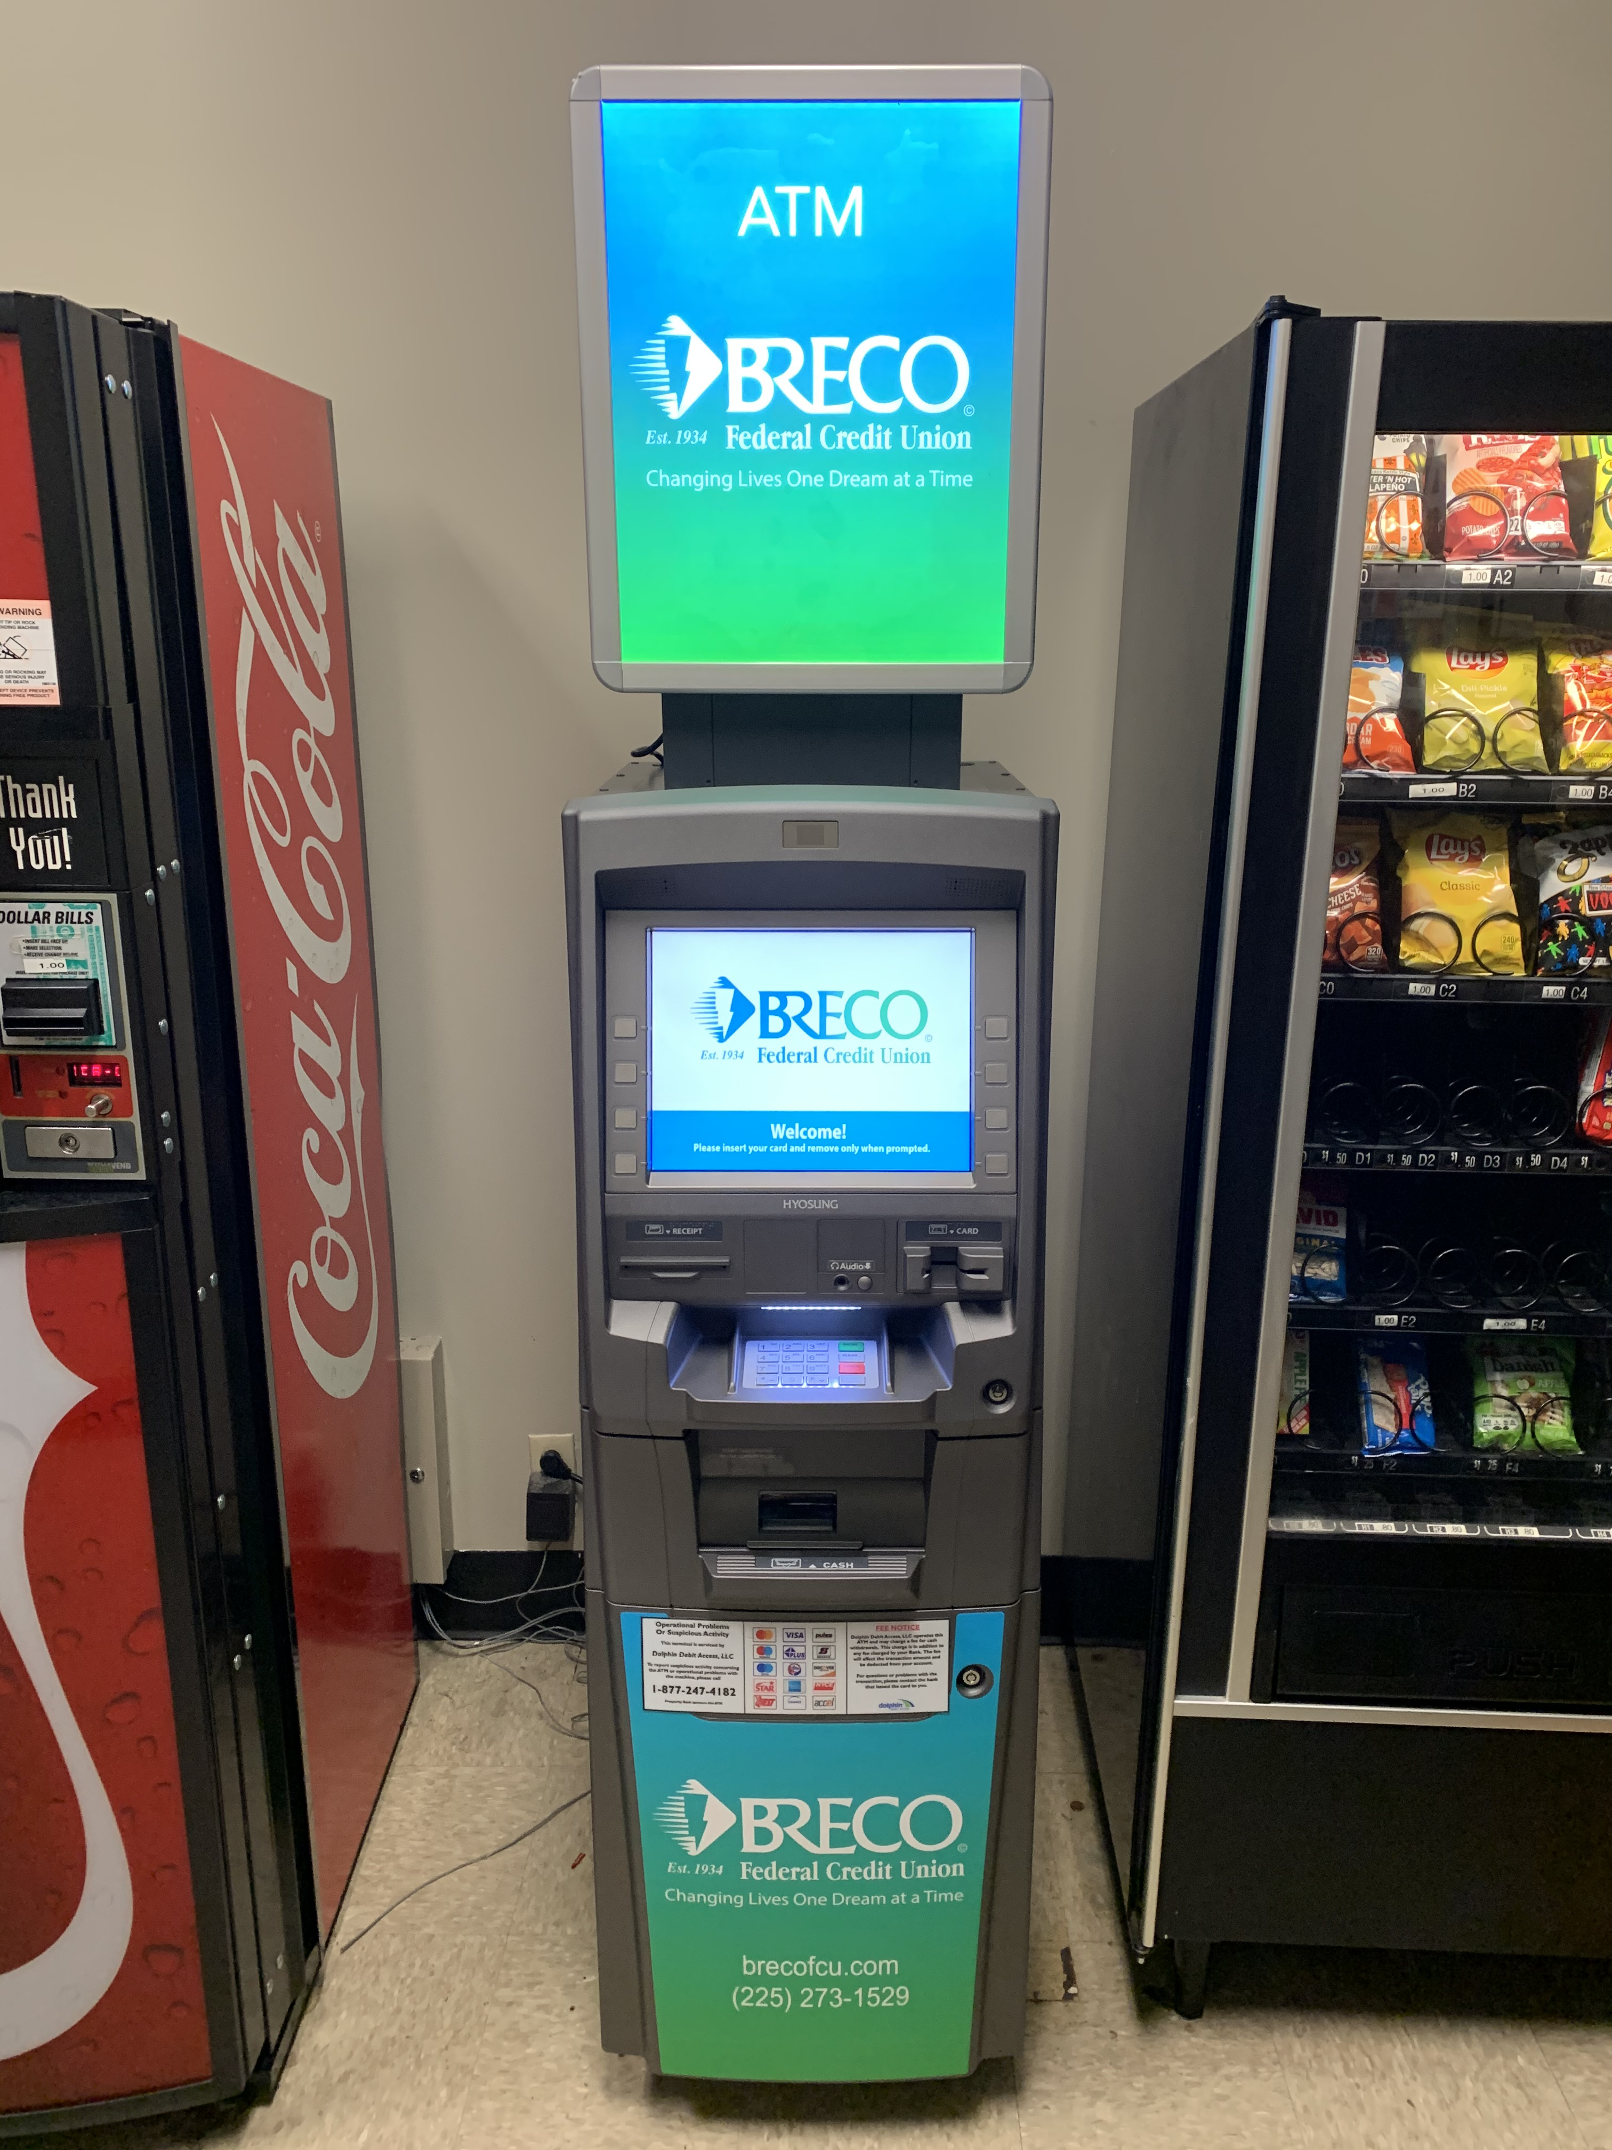
Dolphin’s Monitoring & Dispatch
Dolphin’s Monitoring & Dispatch team is staffed 7 days a week to maximize your ITM uptime & performance.
  Mon-Fri: 6am – 9pm
  Saturday: 8am – 8pm
  Sunday: 8am – 5pm
Dolphin’s Monitoring & Dispatch team can perform:
  Remote access & analysis
  Remote fixes & restarts
  Software loads
  Surcharge changes
  Marketing screen loads and refreshes
  First to technician requests for on-site calls

Slide 40
Strength & Flexibility
Brink’s largest global customer
Equipment agnostic. Operating all NCR & Hyosung units in the field
Best of breed service providers for each market (tech & armor)
In-house monitoring and senior level technician departments
In-house cash team for optimization & management
Options for Dolphin owned & bank owned equipment
Options for bank cash & 3rd party cash management
Host-to-Host connection can add to the transaction set & eliminate network costs

Slide 41
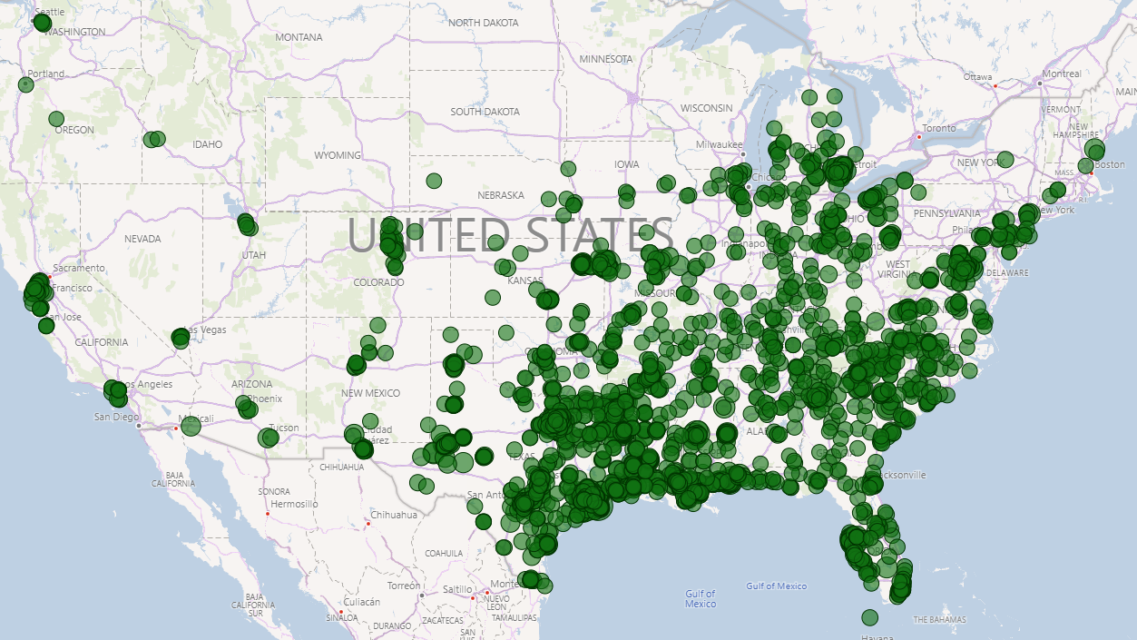
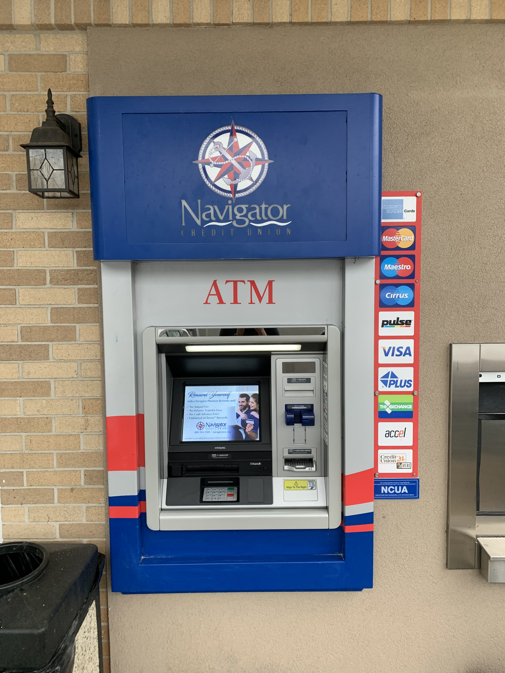
Dolphin’s Surcharge Free ATM Access
Over 2,600 surcharge free ATMs with over 1,300 locations around the Gulf and Mid-Atlantic coasts!

Slide 42
Dolphin Debit – Select ATM Outsourcing Clients
Financial Instution Name | Asset Size | City | State | Number of ATMs
Frost Bank | $42.4B | San Antonio | TX | 91
Dade County | $1.1B | Miami | FL | 72
Texans Credit Union | $2.1B | Richardson | TX | 15
Arkansas FCU | $2.2B | Little Rock | AR | 6
PNC Bank | $392B | Pittsburgh | PA | 20
Wells Fargo | $1.88T | San Francisco | CA | 45
Service Credit Union | $5.8B | Portsmouth | NH | 90
La Capital FCU | $510MM | Baton Rouge | LA | 38
Achieva CU | $2.6B | Dunedin | FL | 31
Red River Employees | $1.3B | Texarkana | TX | 33
Keesler Credit Union | $3.7B | Biloxi | MS | 10
Magnolia FCU | $150MM | Jackson | MS | 13
Energy One FCU | $272MM | Tulsa | OK | 5
Alliance Catholic CU | $600MM | Detroit | MI | 14
Texas Trust CU | $2.0B | Arlington | TX | 65

Slide 43
Thank you!
ATM & ITM-As-a-Service

Slide 44

Next Presentation:

Slide 45

Credit Union Loan Source
A revenue solution for credit unions of all sizes

Slide 46
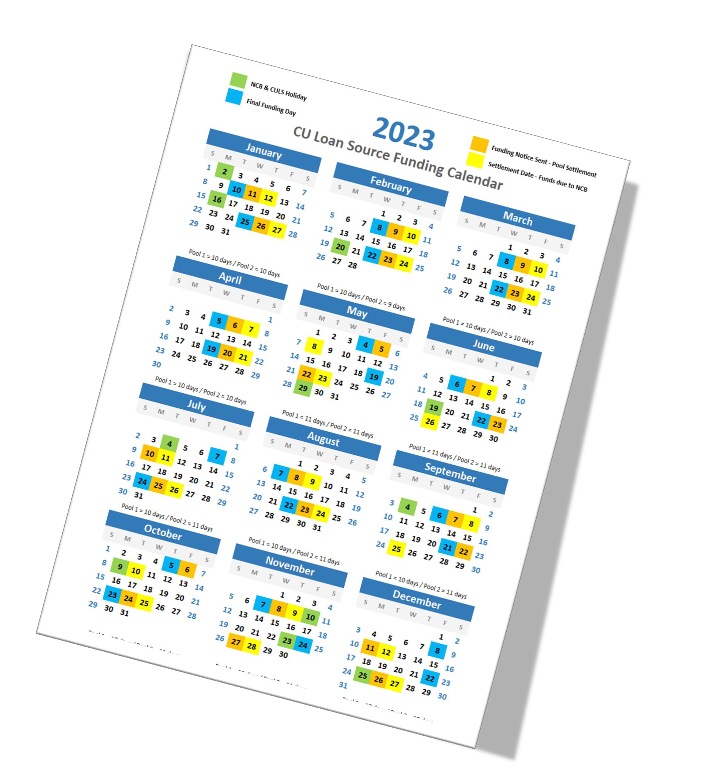

What is this program?
A different kind of Loan Participation

Slide 47

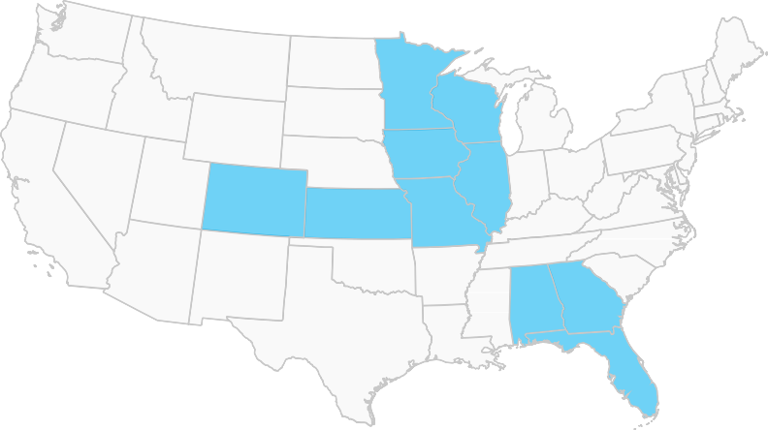

Who is CULS?
We’re a CUSO, owned by credit union organizations
Founded in 2004
$13b+ sold to over 160 credit unions
Auto loans

Slide 48
Why do this?
We’re focused on Yield.
Generate revenue for your members, not from your members.
Flexibility.
In this market conditions are shifting rapidly, we can help.
Scaled risk.
Spread your investment out – reduce your risk.
It’s an easy solution.
We do all the work.

Slide 49
What’s the opportunity?
Reliable income and loan generation
7.45%
Gross Yield
760
Weighted Average FICO

Slide 50

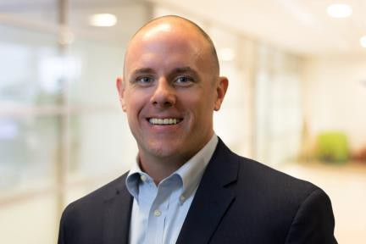
Do you have any questions?
Contact your regional representative and ask them to set up a call
Feel free to reach out!
Go to our website
buyCULSloan.com
Contact us directly KU@culoansource.com LearnMore@culoansource.com

Slide 51
Questions?

Slide 52
Partners Contact Information
Richard Whiddon
Strategic Resource Management Inc.
SVP Business Development
rwhiddon@srmcorp.com
Joe Woods
Dolphin Debit Access
SVP, Marketing & Partnerships
jwoods@dolphindebit.com
Kevin Usiatynski
CU Loan Source
Chief Revenue Officer/
Executive Vice President
kevin.usiatynski@culoansource.com

Slide 53
Cornerstone Resources Contact Information
Ryan Dold
Cornerstone Resources
Chief Revenue Officer
rdold@cornerstoneresources.coop
Tracy Florida
Cornerstone Resources
Partner Relations Manager
tflorida@cornerstoneresources.coop
Natalie Grigar
Cornerstone Resources
Regional Sales Representative
ngrigar@cornerstoneresources.coop
Cynthia Gonzales
Cornerstone Resources
Regional Sales Representative
cgonzales@cornerstoneresources.coop
Ben Quattrochi
Cornerstone Resources
Relationship & Sales Manager
bquattrochi@cornerstoneresources.coop

